Slide 1
Optical Flow & Visual Tracking
Yulai Weng
November 18, 2019

Slide 2
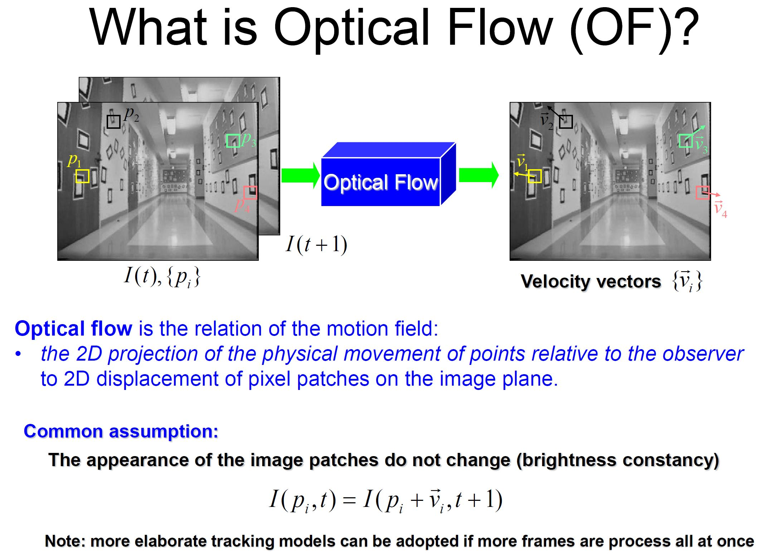
Optical Flow

Slide 3
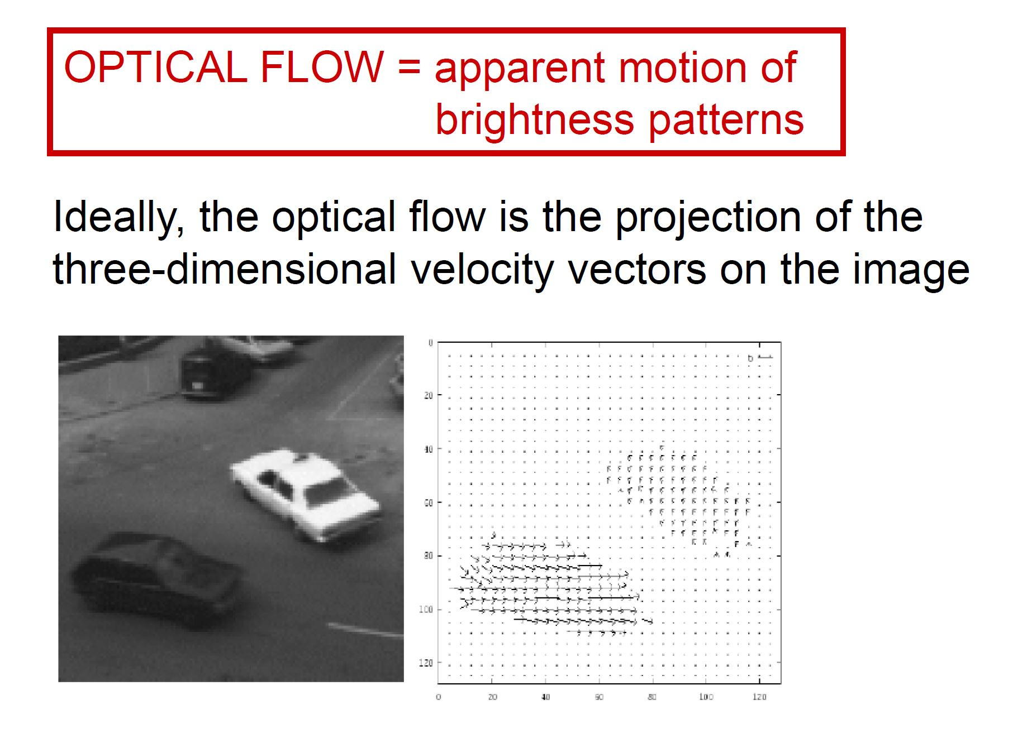
Optical Flow

Slide 4
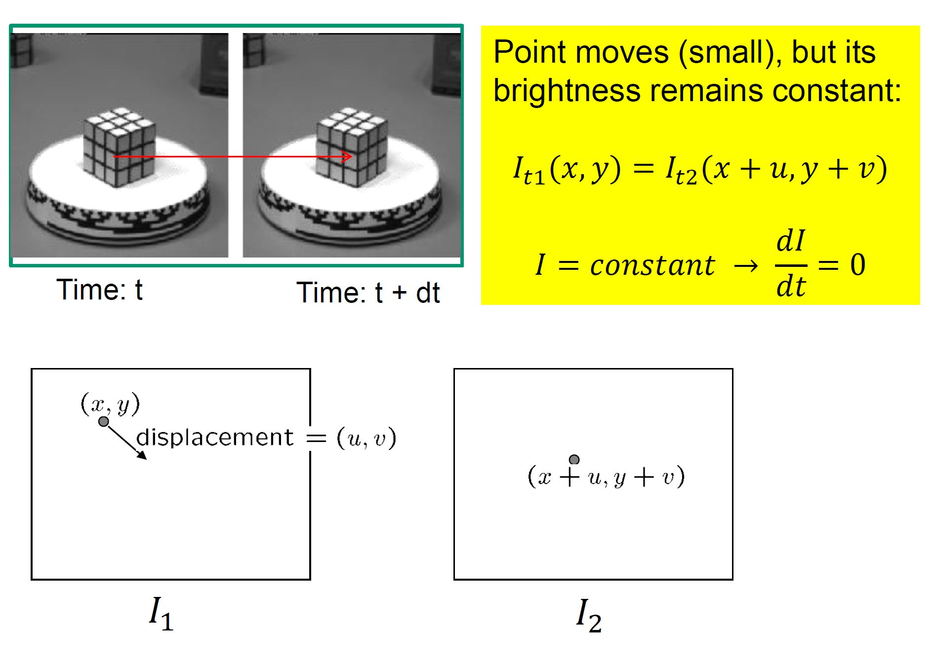
Brightness Constancy

Slide 5
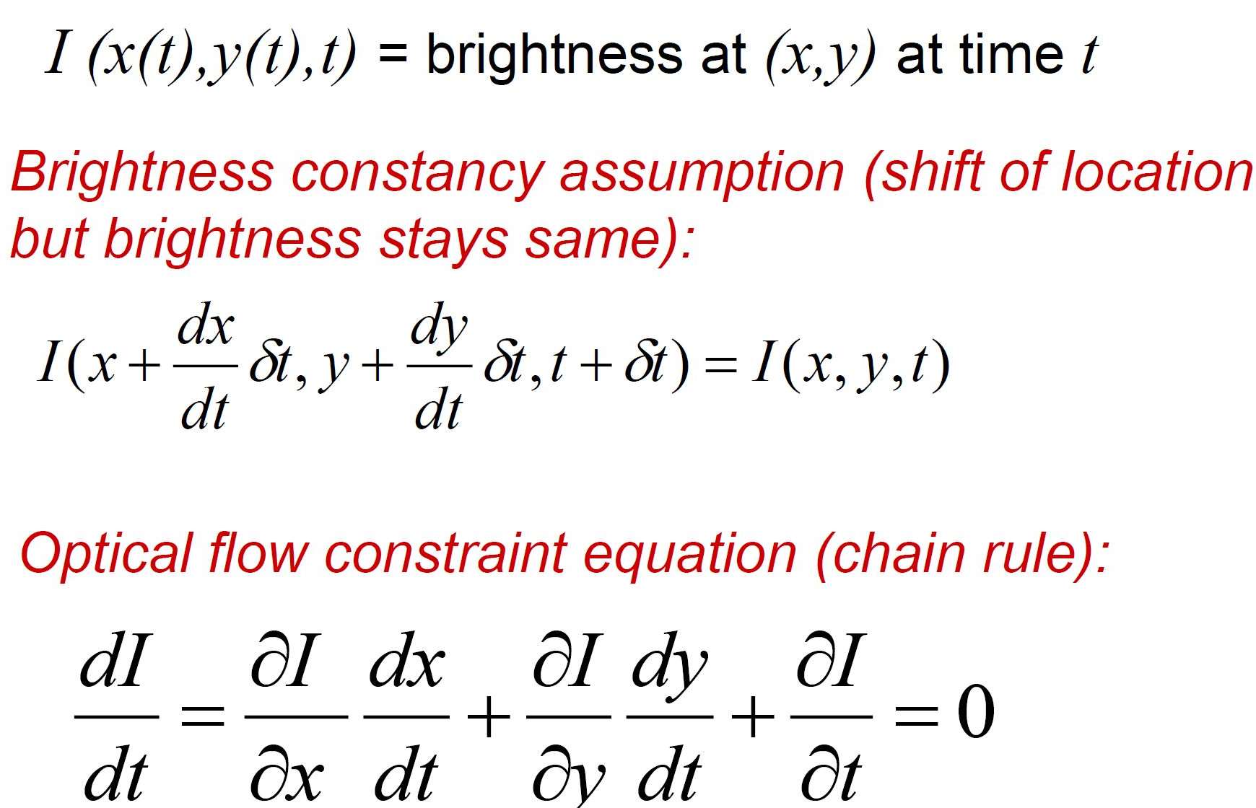
Mathematical Formulation

Slide 6
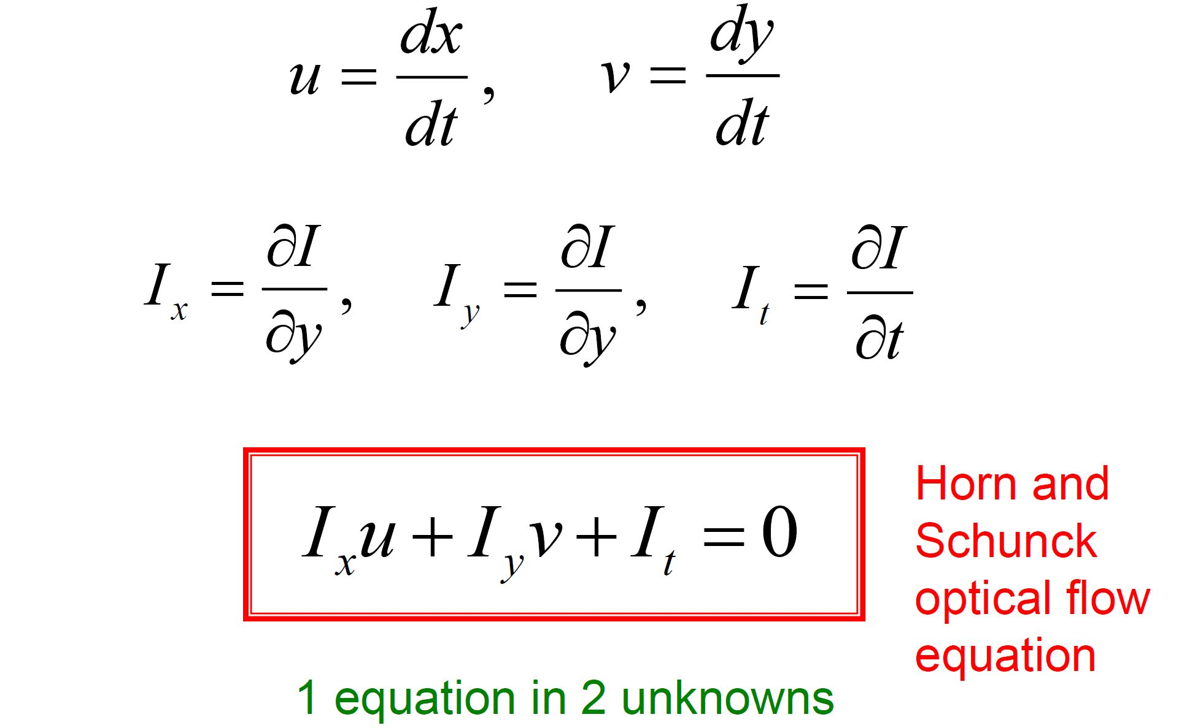
Aperture Problem

Slide 7
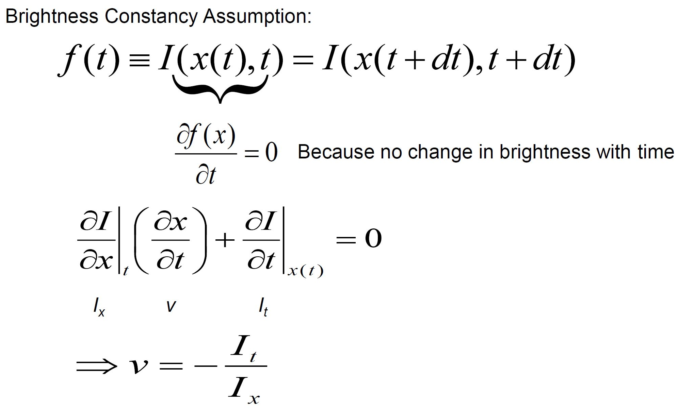
Optical Flow: 1D Case

Slide 8
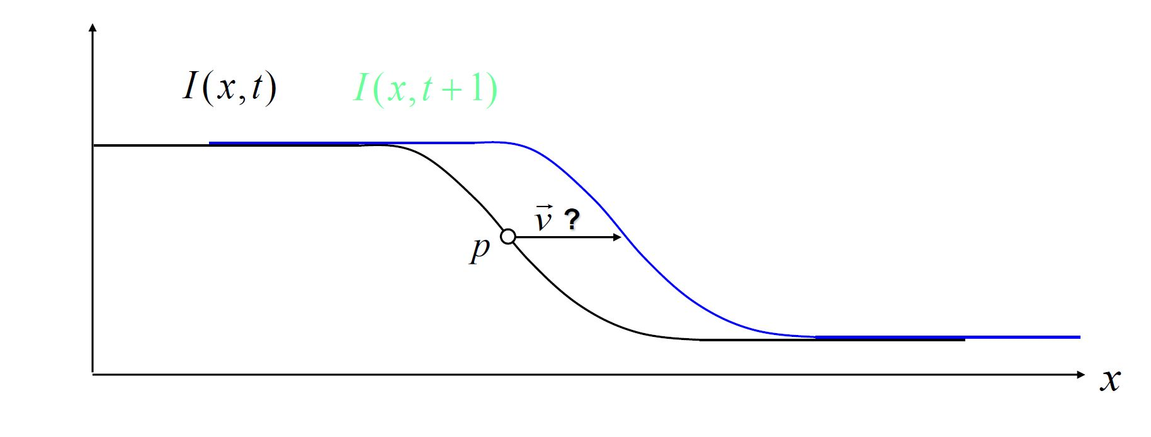
Tracking in 1D Case

Slide 9
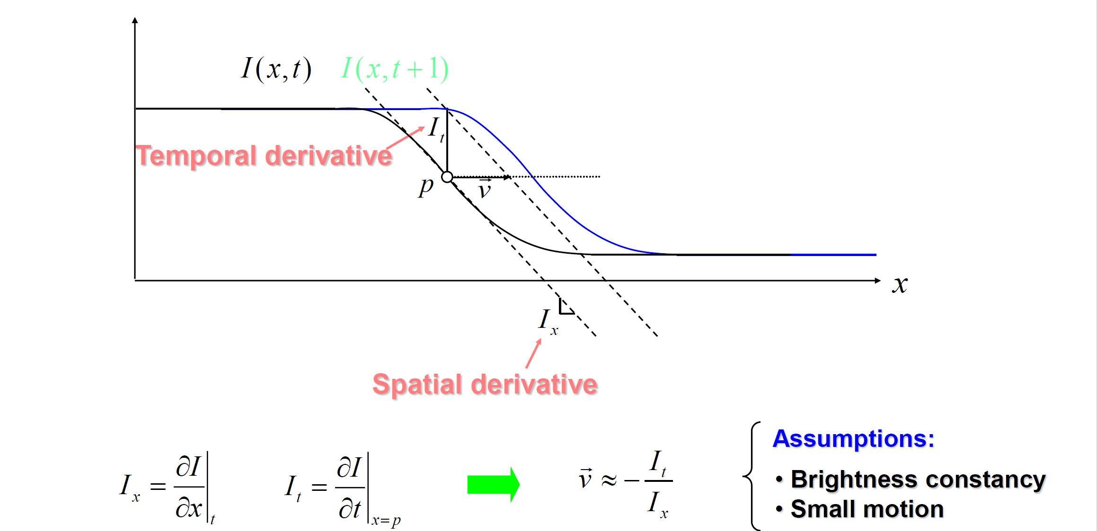
Tracking in 1D Case

Slide 10
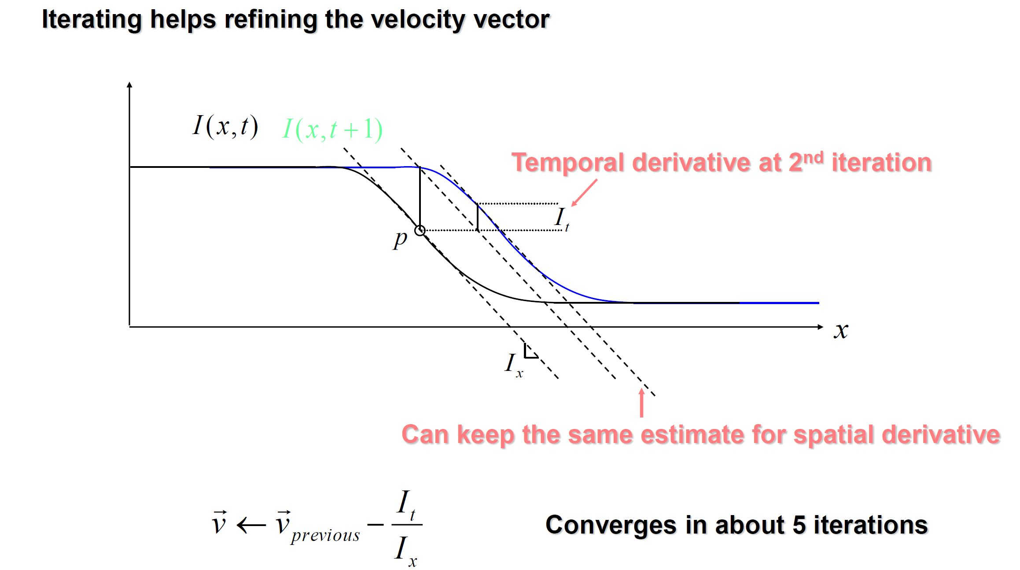
Tracking in 1D Case

Slide 11
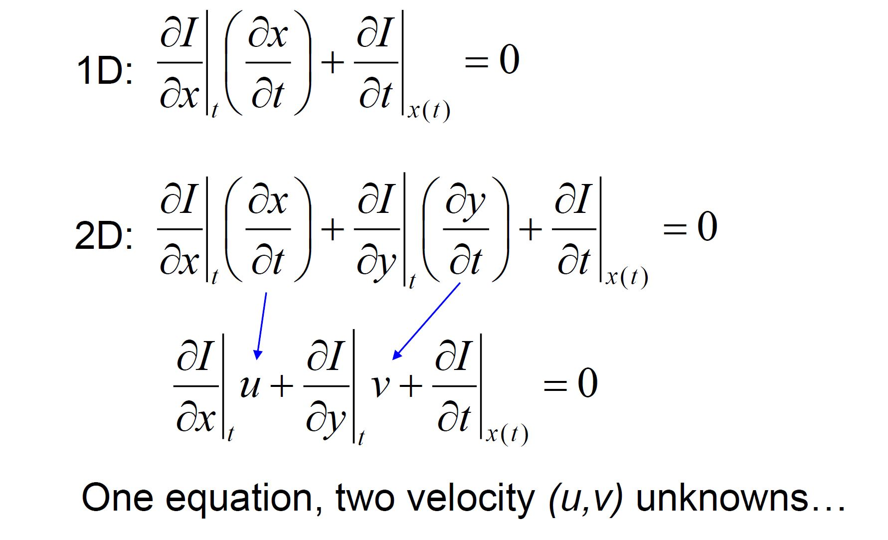
From 1D to 2D Tracking

Slide 12
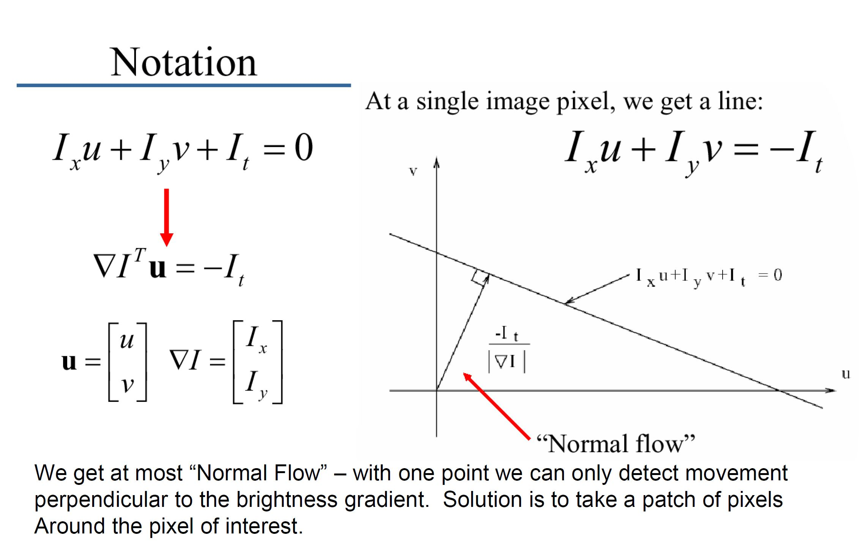
Normal Flow

Slide 13
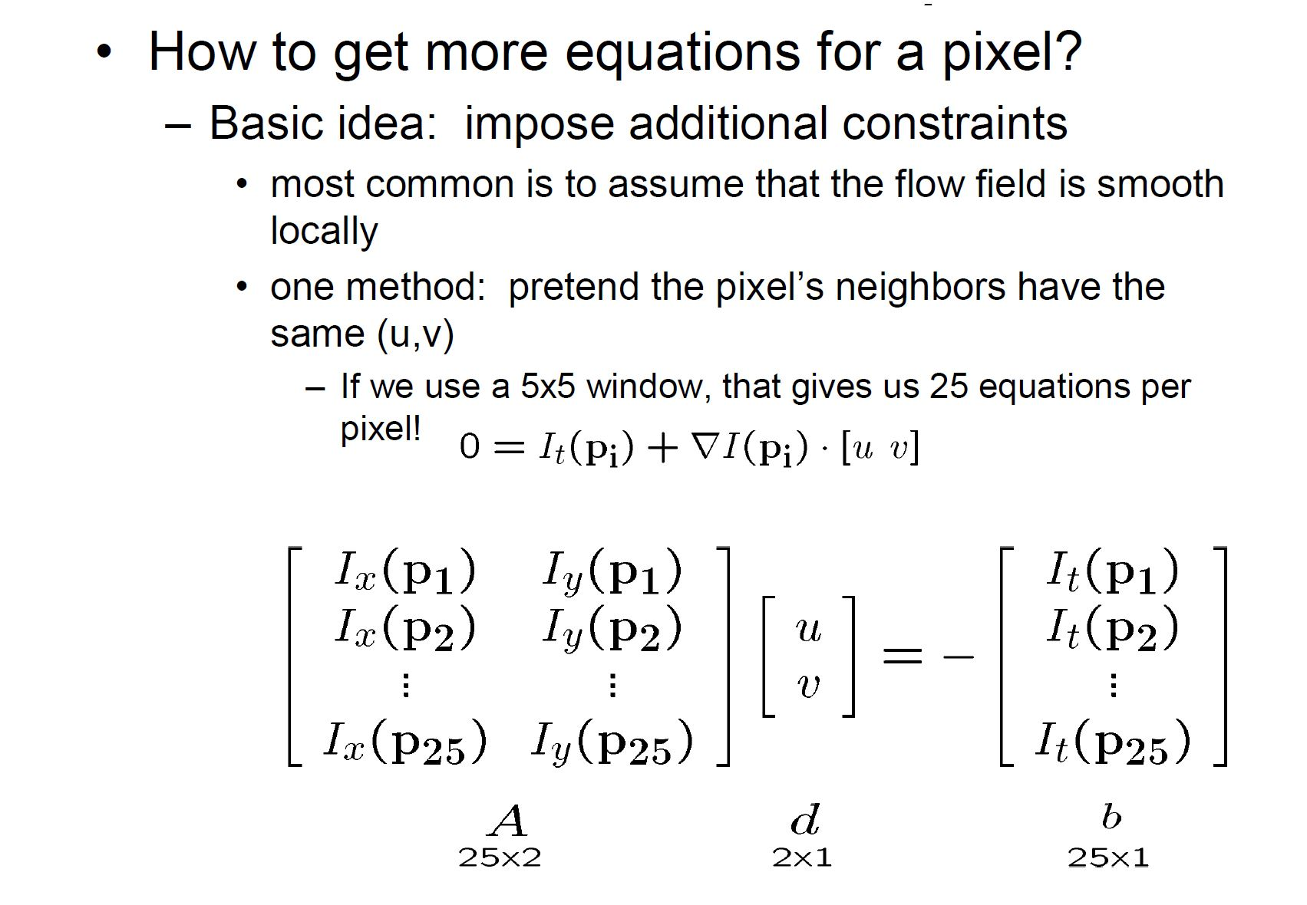
Solving Apeture Problem

Slide 14
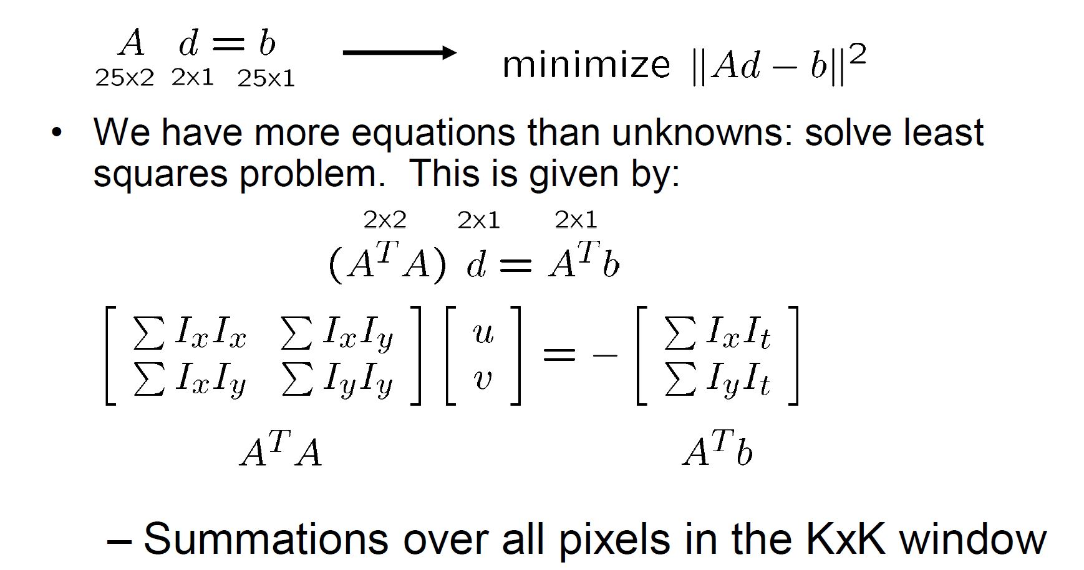
Lucas-Kanade Flow

Slide 15
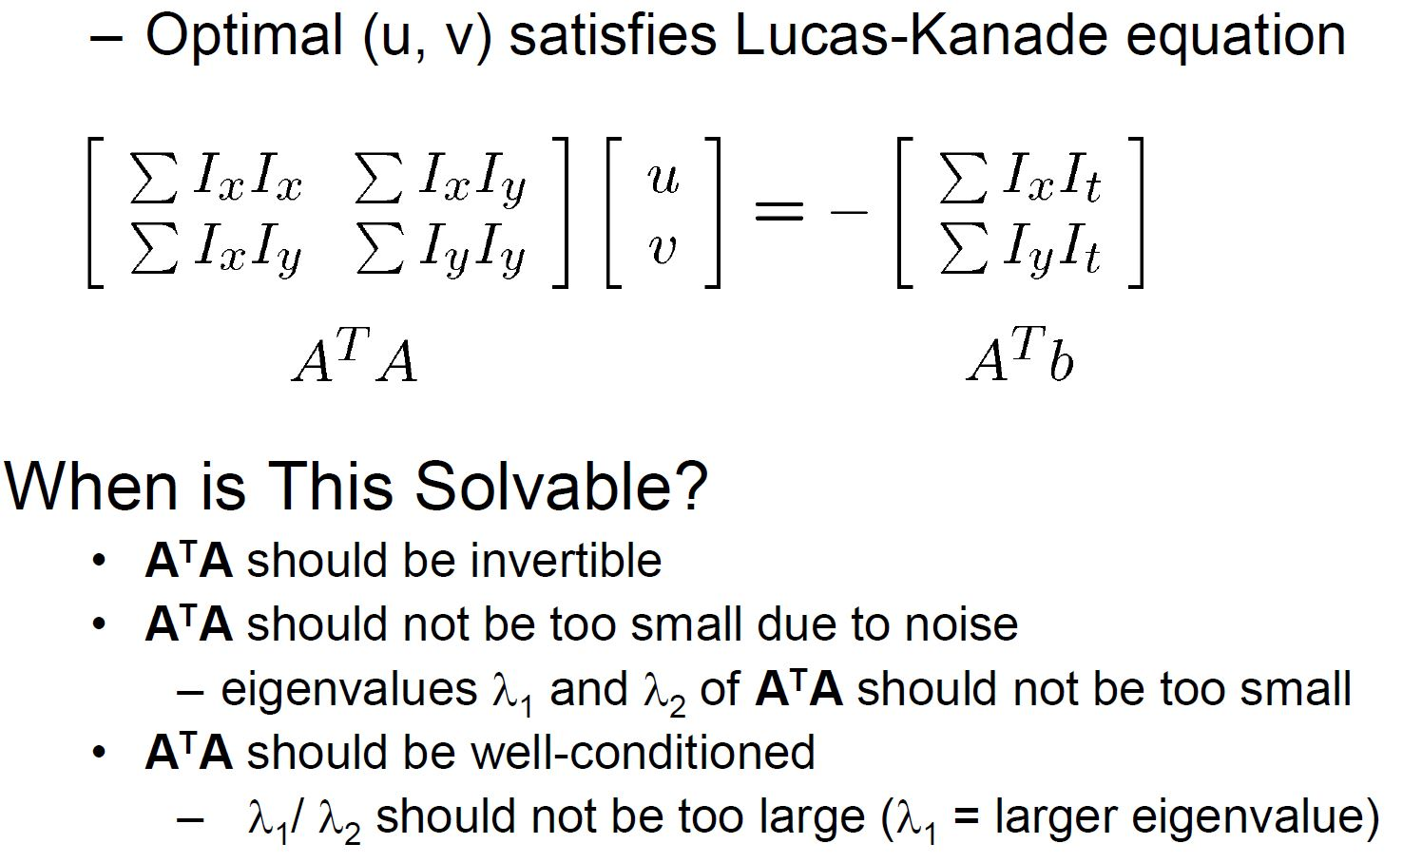
Condition for Solvability

Slide 16
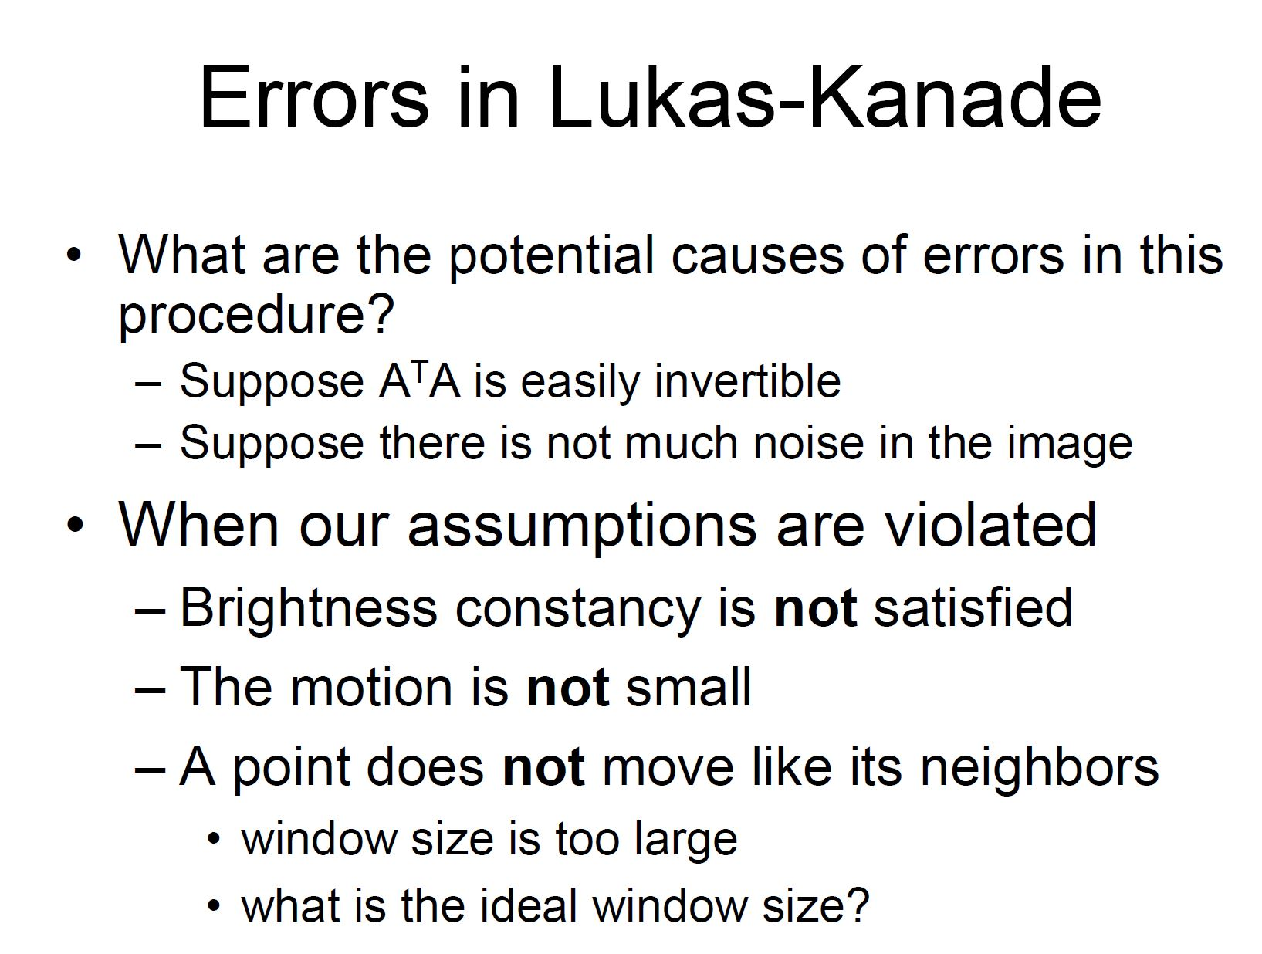
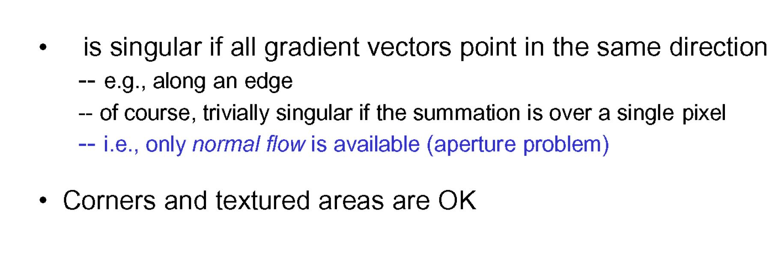

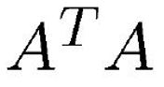
Errors in Lucas Kanade

Slide 17
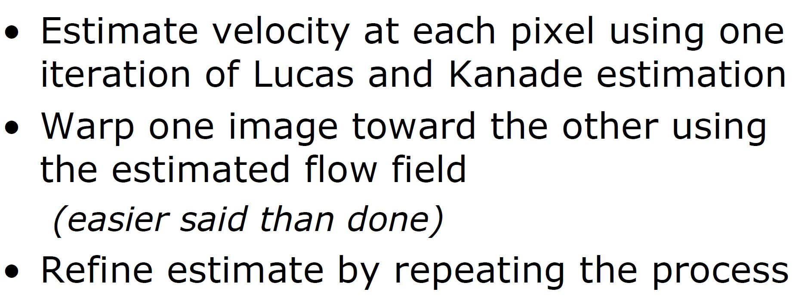
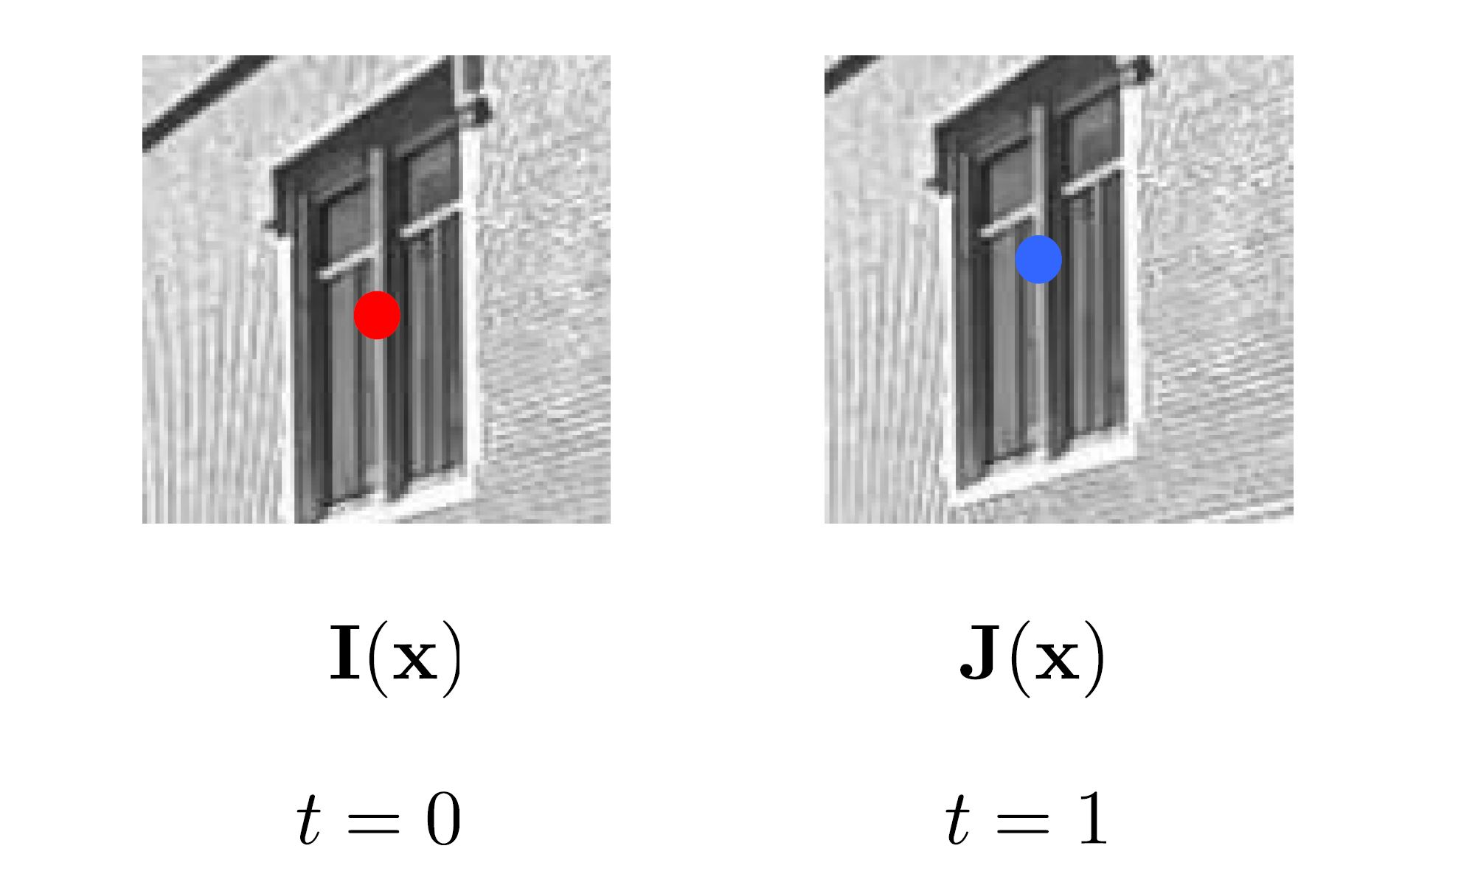
Iterative Refinement

Slide 18
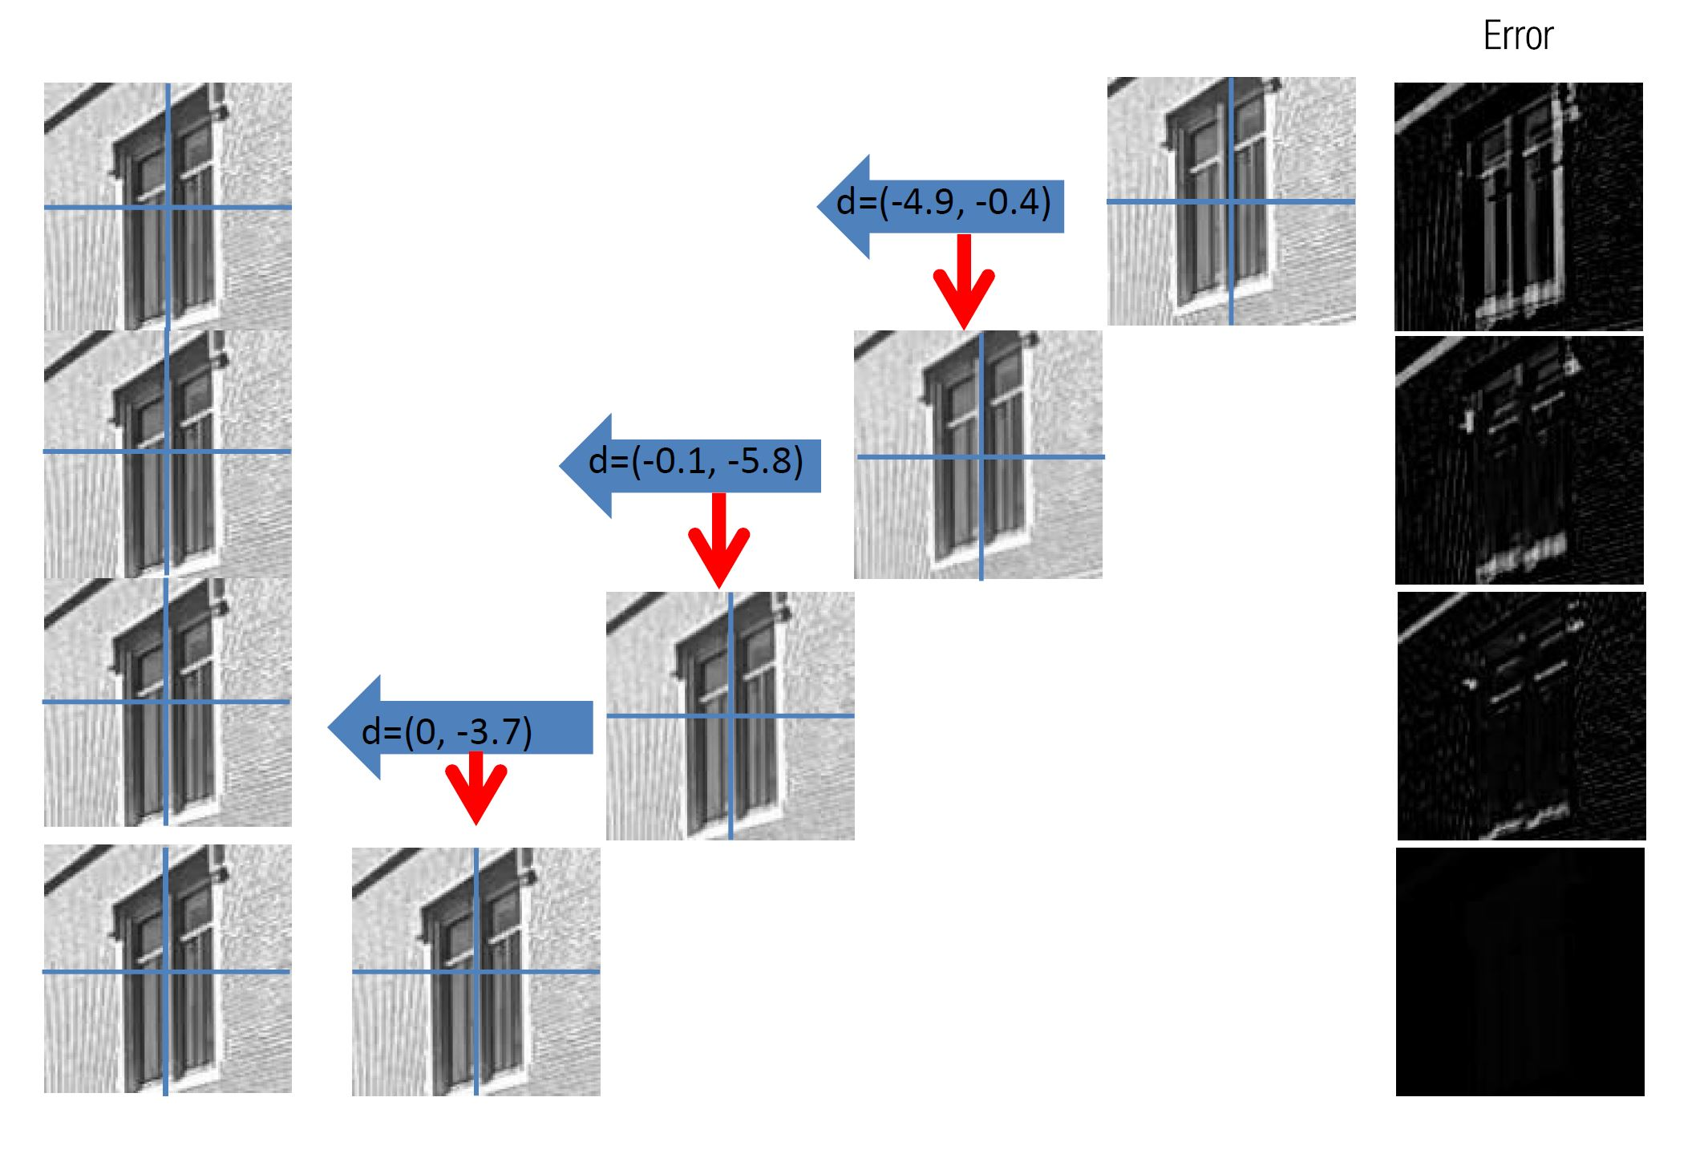
Iterative Refinement

Slide 19
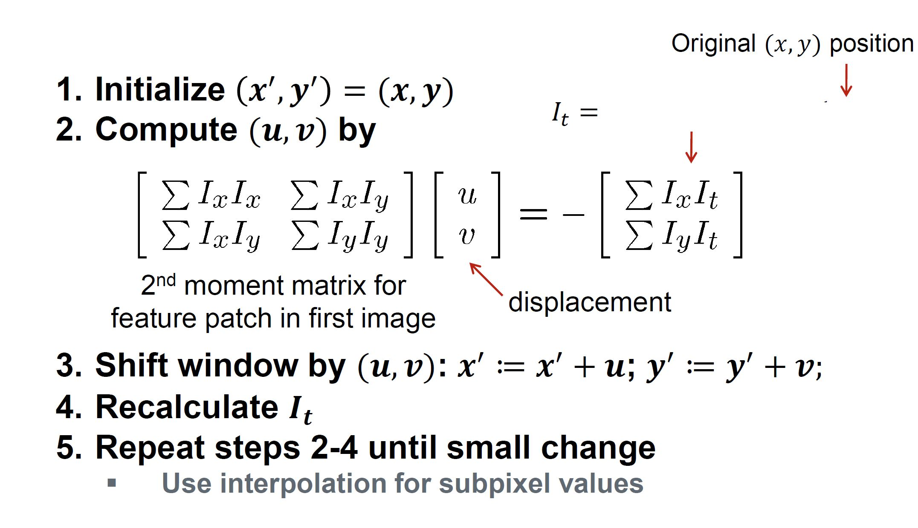
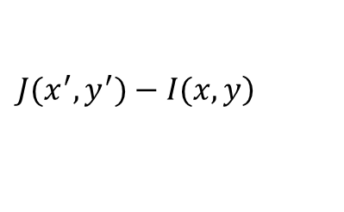
Iterative Refinement
$$\left.J(x^{′},y^{′})−I(x,y\right)$$

Slide 20
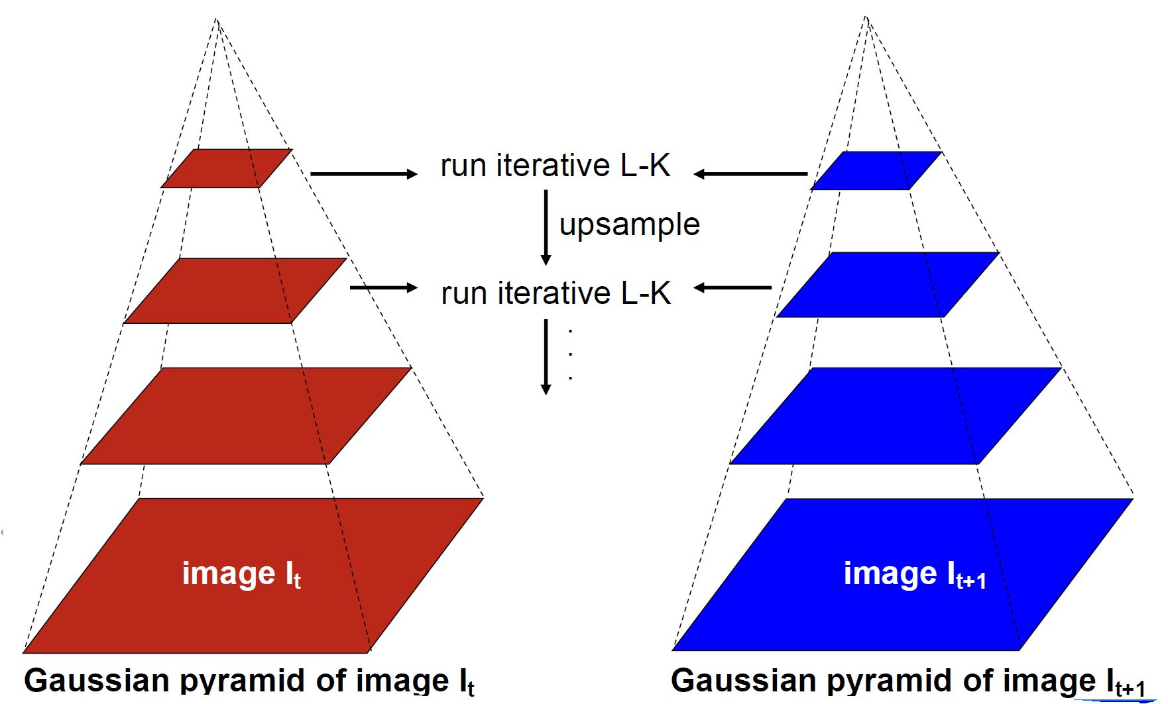
Coarse to Fine Image Pyramid

Slide 21
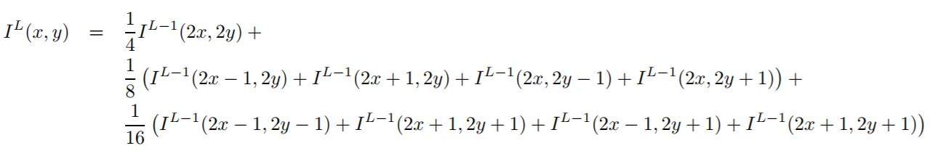
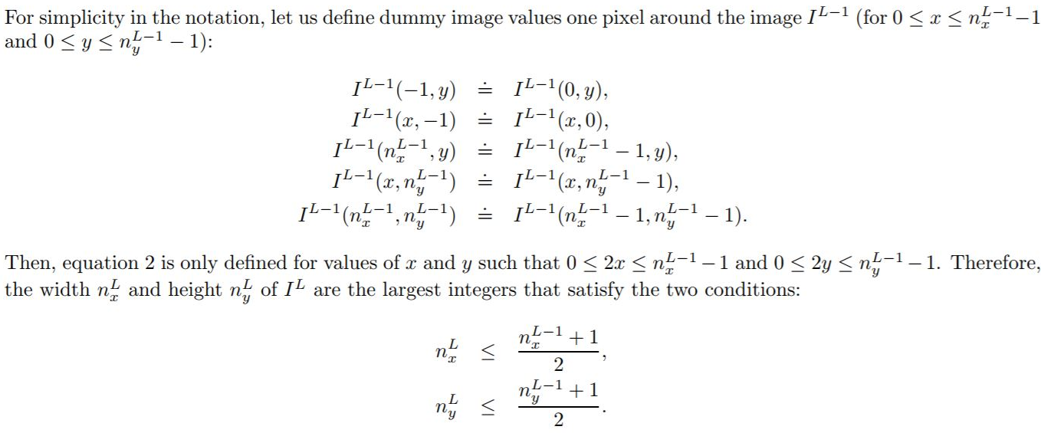
Build Image Pyramid

Slide 22
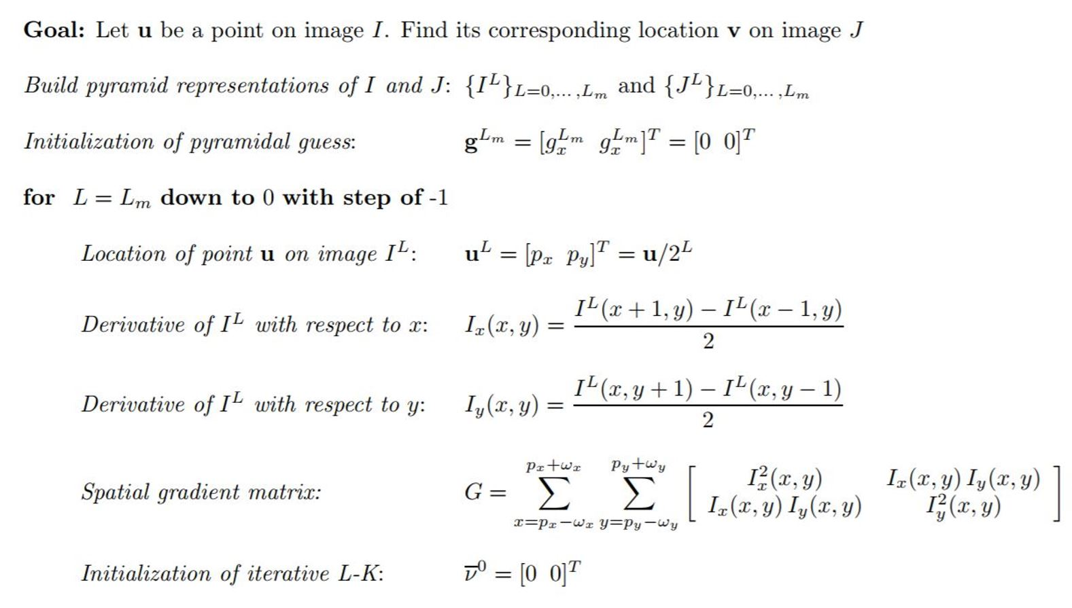
Tracking in Image Pyramid

Slide 23
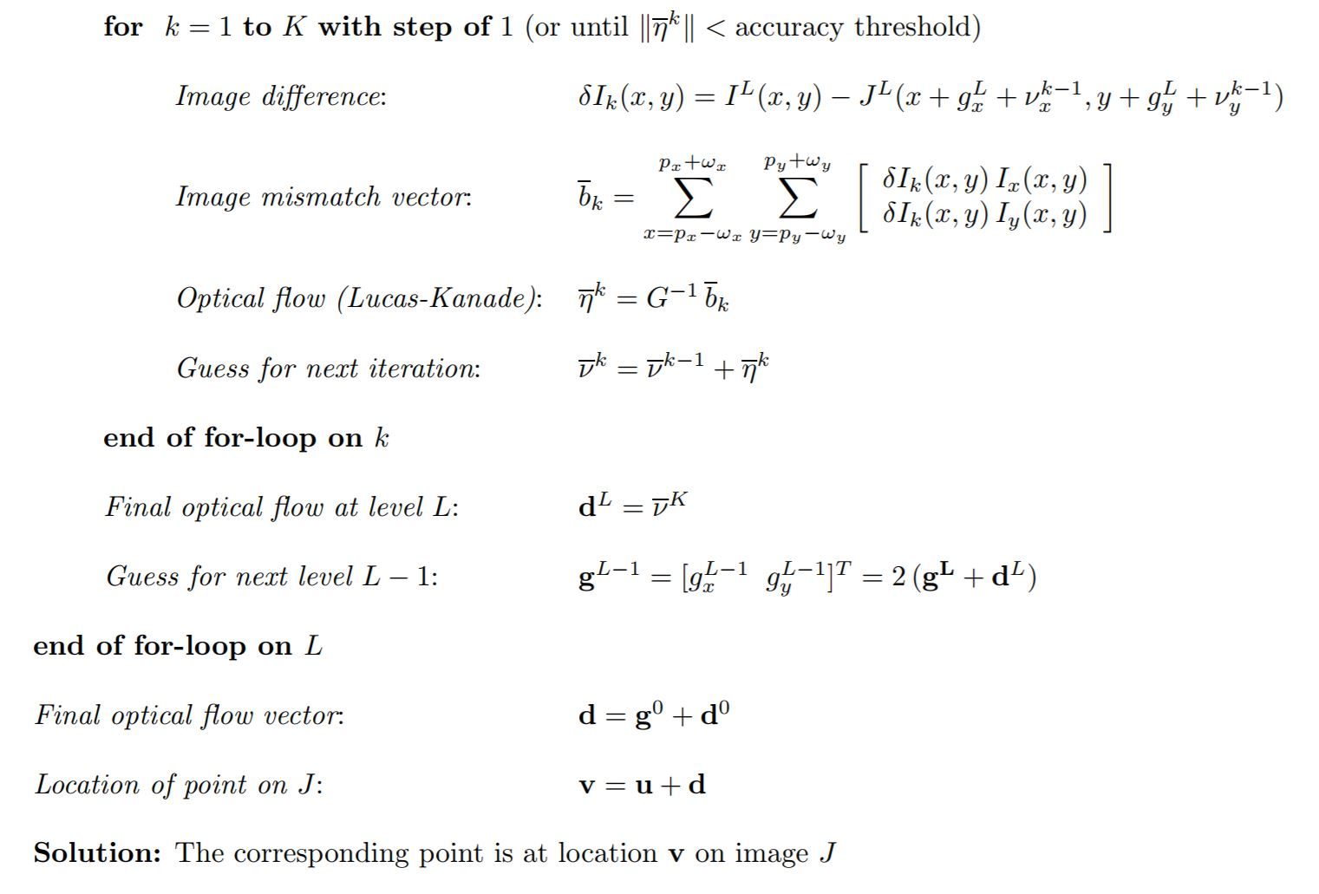
Tracking in Image Pyramid

Slide 24

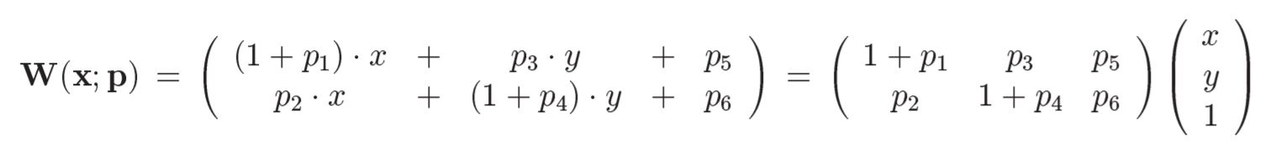
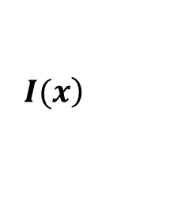
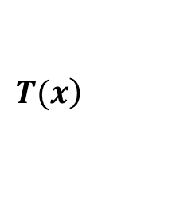
Affine Warp
Optical Flow: Translation Warp
Affine Warps (May handle more deformable image patch)
If we assume current frame at t , called template image
next frame at t+1 , called source image
$$\left.T(x\right)$$
$$\left.I(x\right)$$

Slide 25
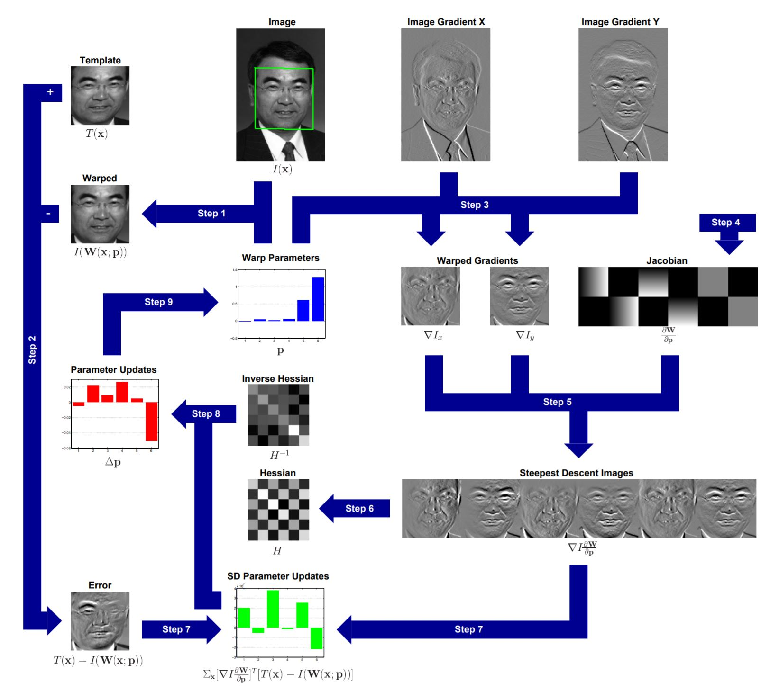
General Lucas-Knade Image Alignement

Slide 26
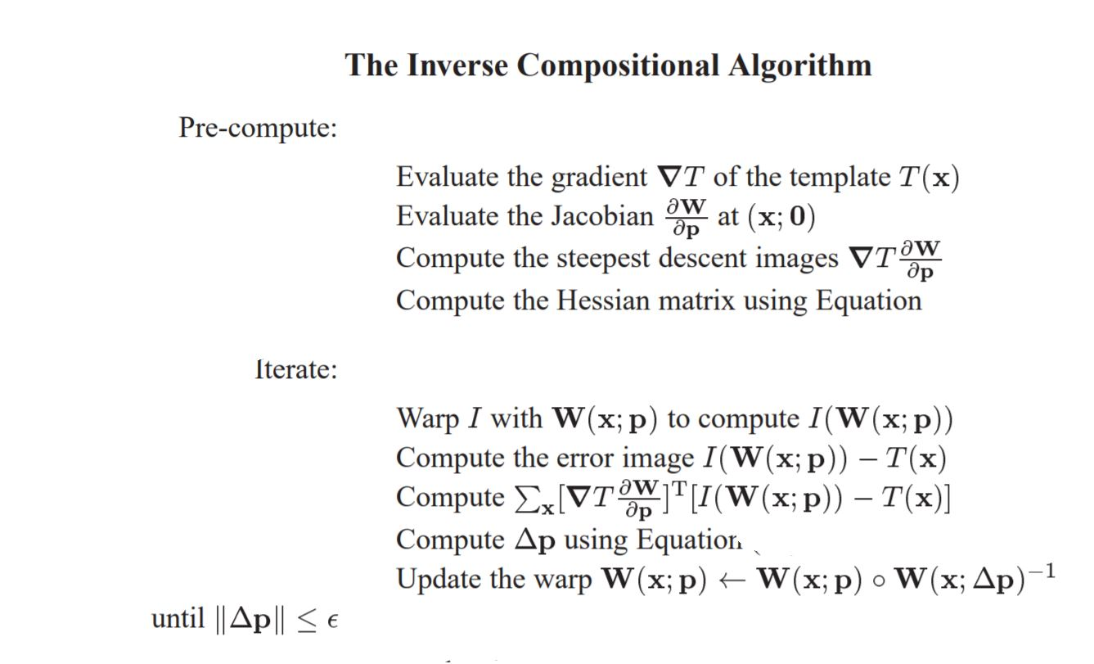
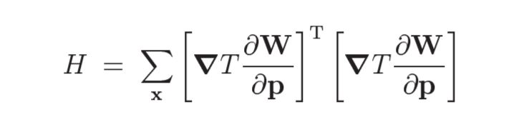
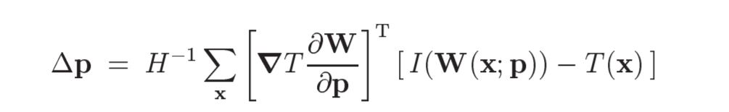
General Lucas-Knade Image Alignement

Slide 27
Similarity Transform
tform = skimage.transform.estimate_transform('similarity', src, dst)
tformp=np.asmatrix(tform.params)
coordnew=tformp.dot(coord)
Eliminate Bad Feature

Slide 28
Thanks !

